Slide 1
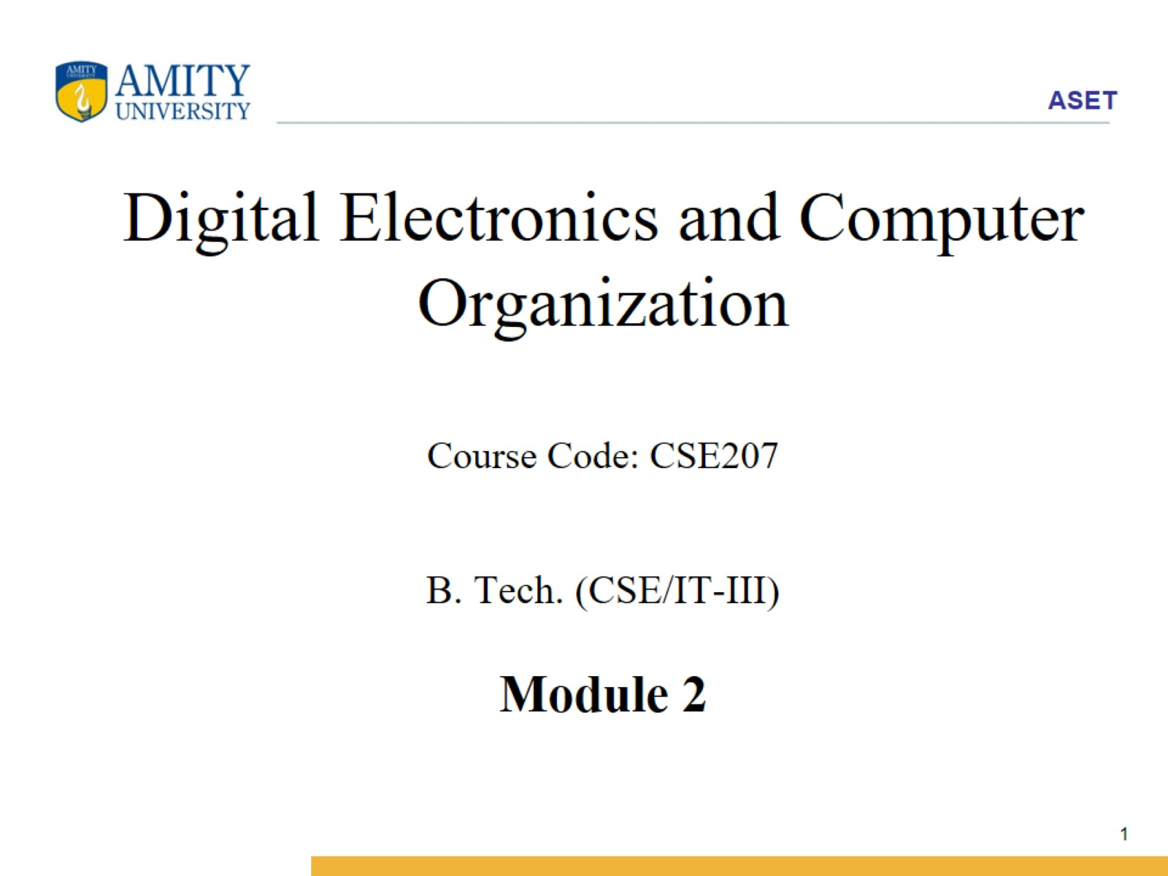
Digital Electronics and Computer Organization Course Code: CSE207 B. Tech. (CSE/IT-III) Module 2

Slide 2
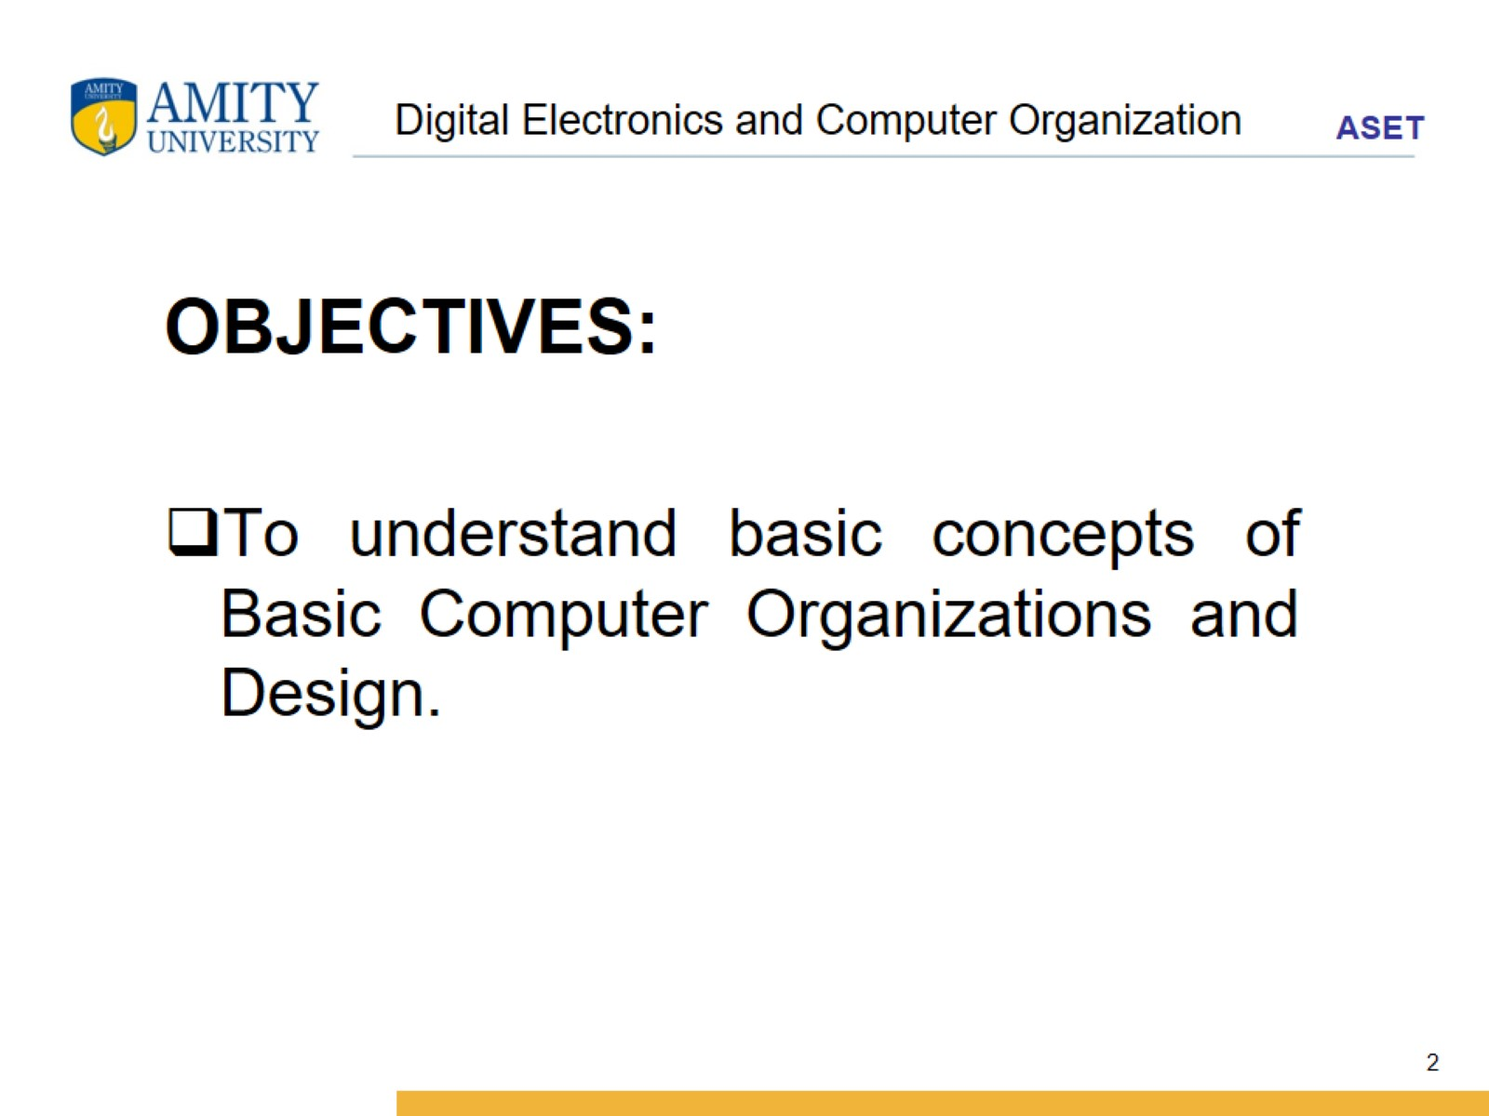
Digital Electronics and Computer Organization

Slide 3
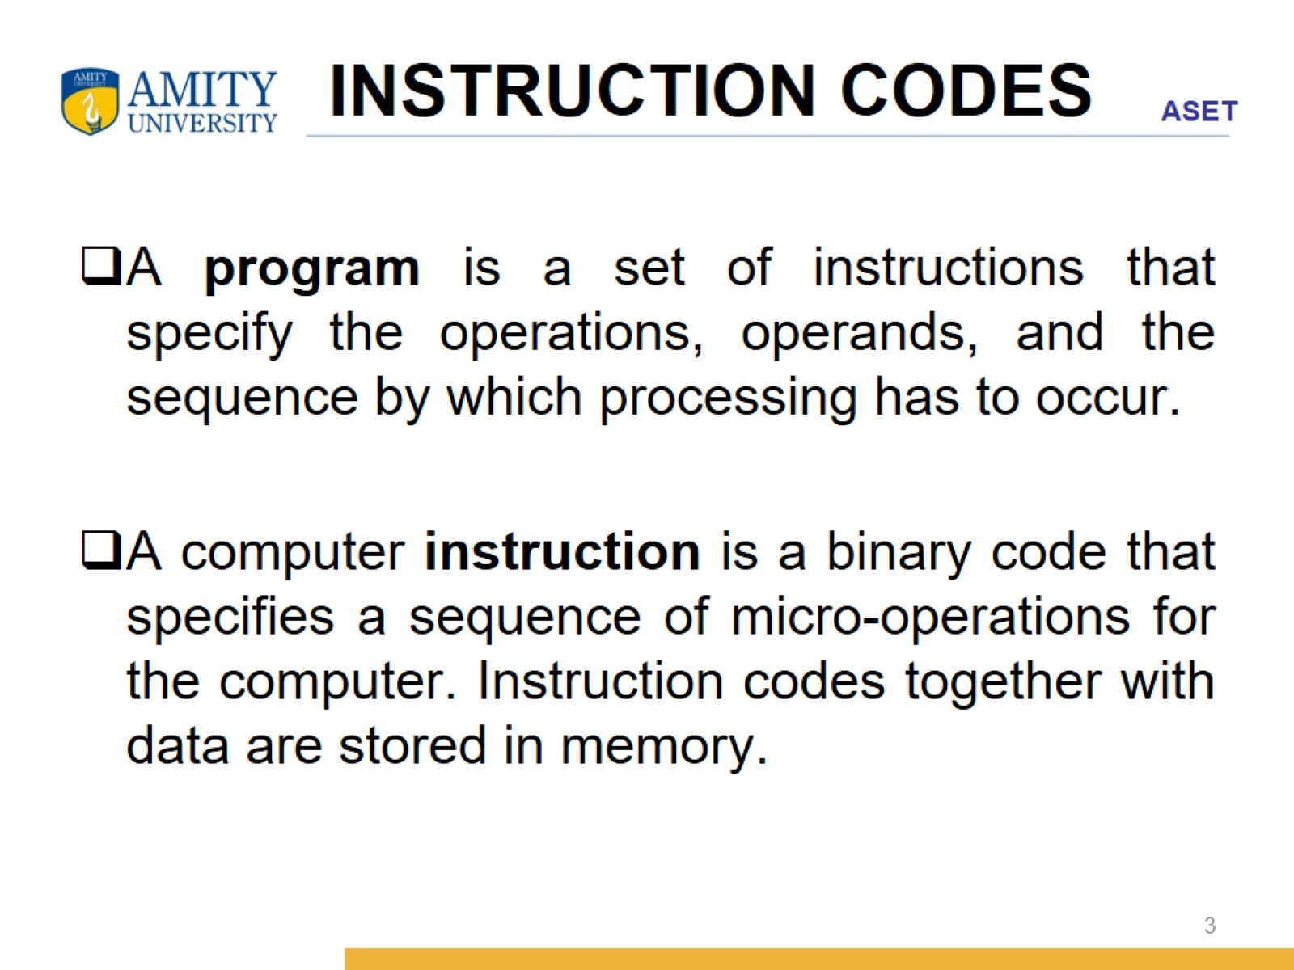
INSTRUCTION CODES

Slide 4
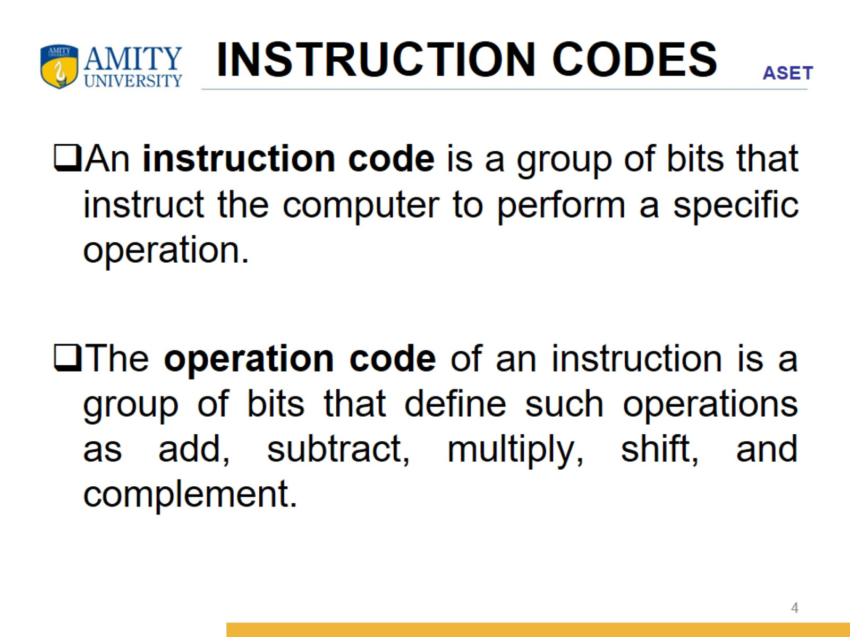
INSTRUCTION CODES

Slide 5
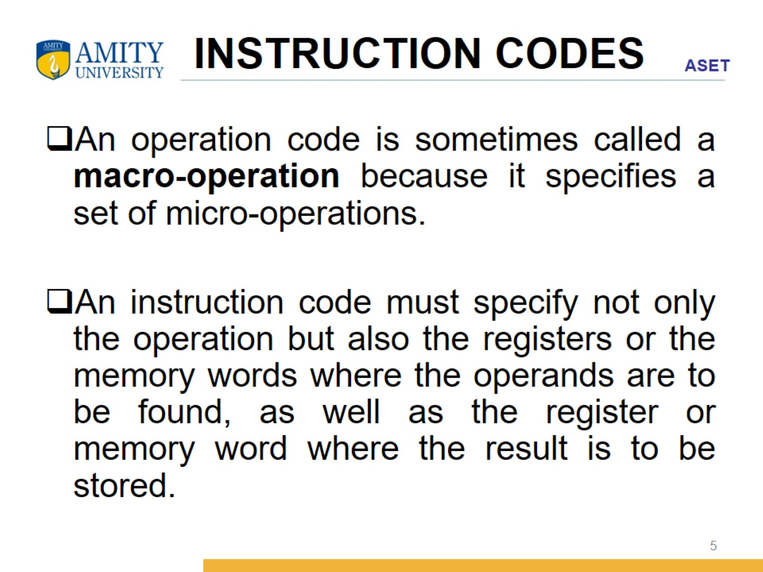
INSTRUCTION CODES

Slide 6
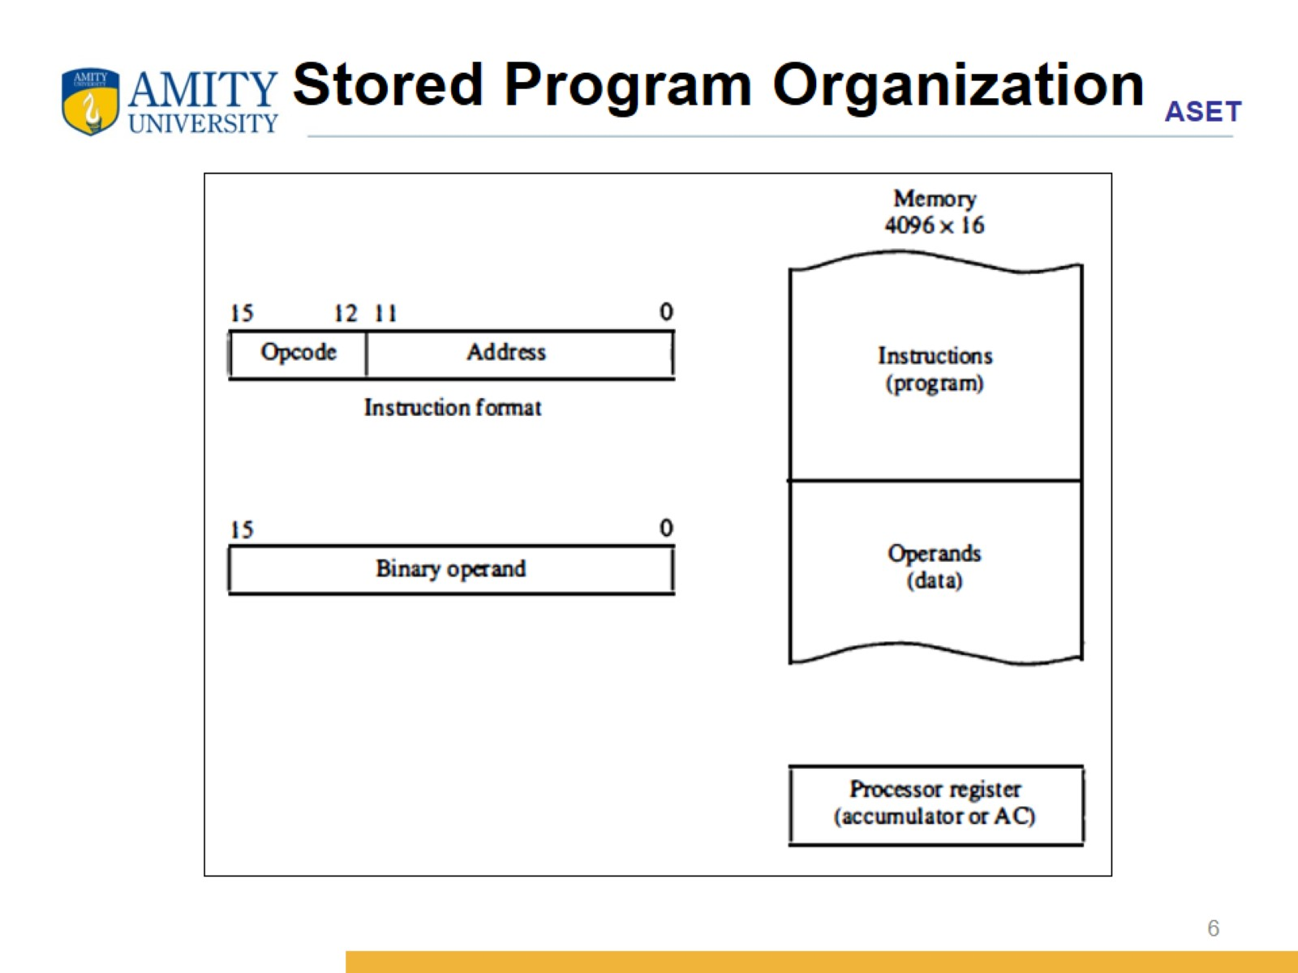
Stored Program Organization

Slide 7
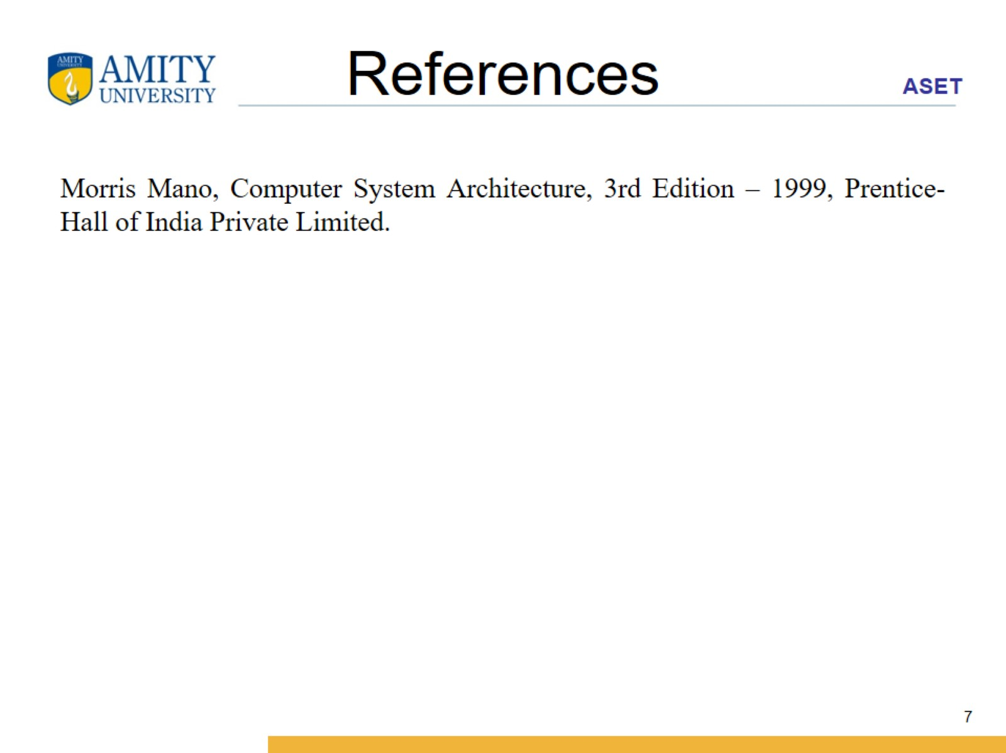
References

